Slide 1

Housing price Prediction & EDA Project
Intern/Data Analyst: Next Hikes IT Solutions Project date: 5th Oct 2025 Presented by: Sonal Gaikwads

Slide 2

Introduction
In this project, a housing dataset was analyzed to understand the factors influencing house prices. Exploratory Data Analysis (EDA) was performed to identify trends and patterns in the data. Feature engineering was applied to create new attributes that provide deeper insights. Houses were grouped into clusters to understand different market segments, and finally, a regression model was built to predict house prices.

Slide 3
Data Cleaning
Before performing analysis, the dataset was cleaned to remove inconsistencies. Missing values such as LotFrontage were filled using the median. Irrelevant columns like Alley, PoolQC, and Fence were removed since they contained too many missing entries. Duplicate records were also dropped to ensure data accuracy. This cleaning process helped prepare the dataset for reliable analysis and modeling.

Slide 4
Exploratory Data Analysis (EDA)
The distribution of SalePrice was initially right-skewed, which made it less suitable for modeling. To address this, a log transformation was applied, making the distribution closer to normal. Outliers in variables such as SalePrice and GrLivArea were detected using boxplots. A correlation heatmap was also created, which revealed that features like OverallQual, GrLivArea, and GarageCars have strong positive relationships with SalePrice.

Slide 5
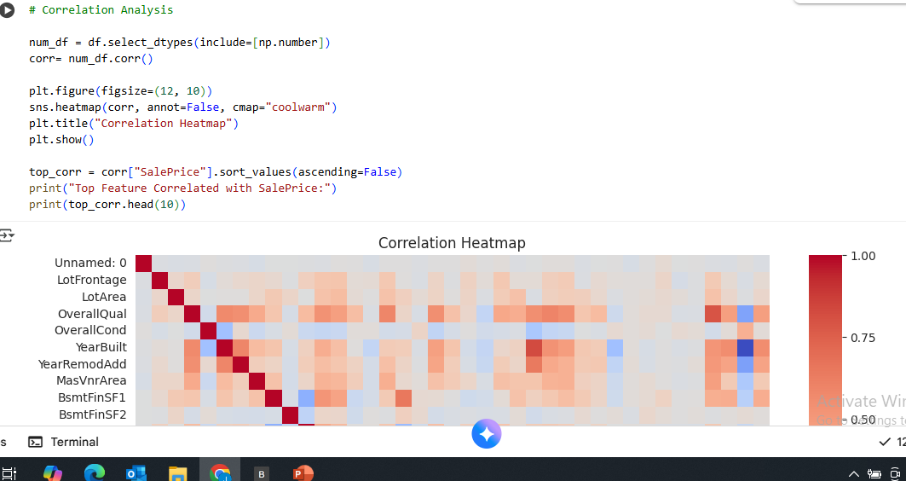
Exploratory Data Analysis (EDA)
The distribution of SalePrice was initially right-skewed, which made it less suitable for modeling. To address this, a log transformation was applied, making the distribution closer to normal. Outliers in variables such as SalePrice and GrLivArea were detected using boxplots. A correlation heatmap was also created, which revealed that features like OverallQual, GrLivArea, and GarageCars have strong positive relationships with SalePrice.

Slide 6
Feature Analysis
A deeper analysis of individual features showed that SalePrice increases with GrLivArea, meaning that larger living areas usually result in higher prices. Similarly, higher values of OverallQual, which represents overall quality, also lead to higher prices. New features were engineered for better analysis: PricePerSqft was calculated as SalePrice divided by GrLivArea, and HouseAge was derived from the year the house was built. These features provided additional insights into property valuation.

Slide 7
Market and Neighborhood Trends
Market analysis revealed that average prices change over time, depending on the year of sale. Neighborhood also had a strong influence on SalePrice, showing that location is one of the most important factors in real estate. Additionally, amenities such as fireplaces and the number of garage cars contributed positively to house prices. This analysis highlights that both external factors like location and internal features like amenities significantly affect pricing.

Slide 8
Clustering (KMeans)
KMeans clustering was applied to group houses into three distinct categories: luxury, mid-range, and affordable. The clustering was based on important features such as GrLivArea, OverallQual, and GarageCars. This segmentation helps in understanding different market segments and is useful for businesses to target customers more effectively.

Slide 9
Regression Model
A regression model was built using important features such as GrLivArea, OverallQual, GarageCars, and HouseAge to predict house prices. Linear regression was chosen as the model, and its performance was evaluated using R² score and RMSE. The R² score indicates how well the model explains the variation in SalePrice, while RMSE shows the average error in predictions. The model performed reasonably well, showing that house prices can be predicted with fair accuracy.

Slide 10
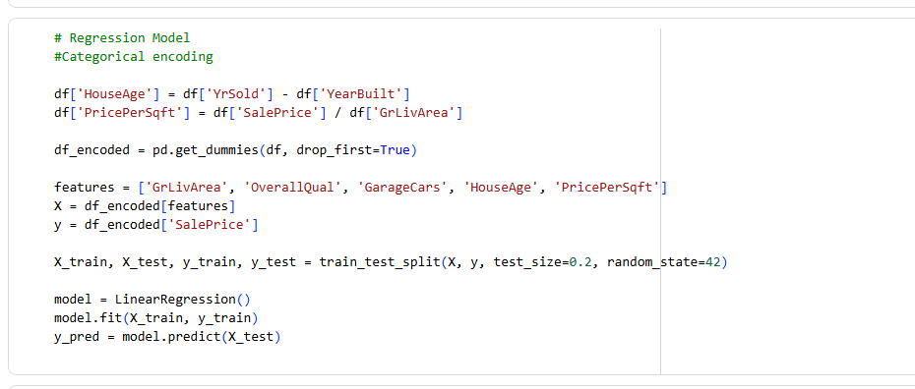
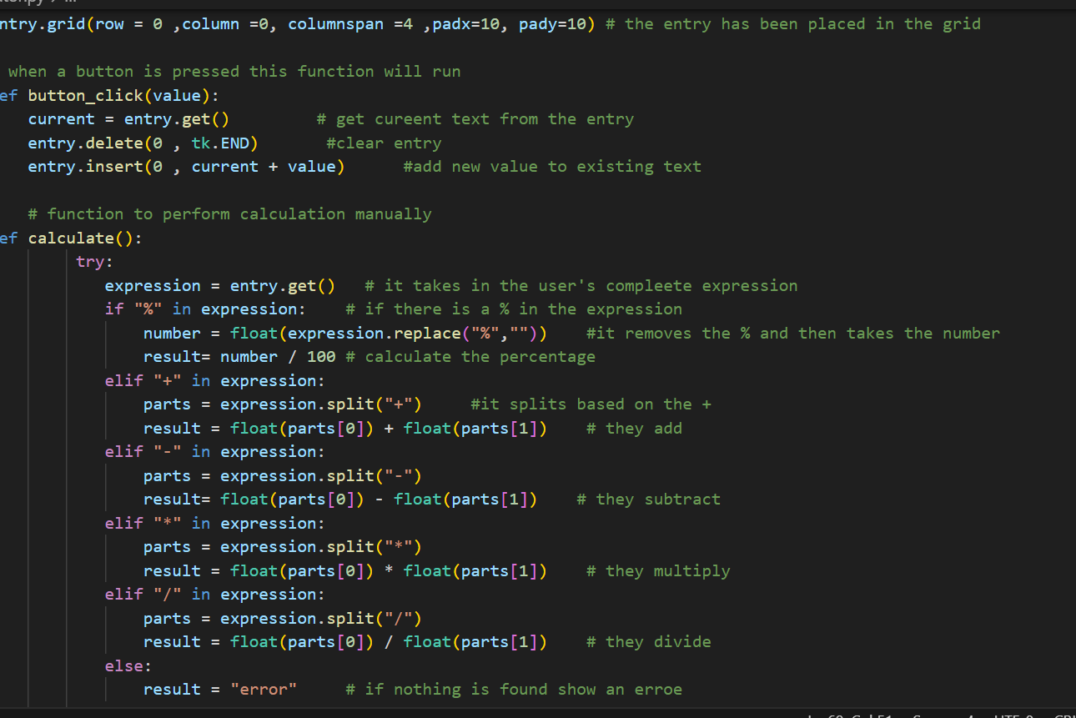

Slide 11
The project concluded that SalePrice is strongly influenced by features such as OverallQual, GrLivArea, and GarageCars. The engineered features PricePerSqft and HouseAge provided more detailed understanding of property value. Market trends showed yearly fluctuations, and neighborhood analysis proved that location has a major impact. Finally, the regression model demonstrated that house prices can be predicted effectively, while clustering helped classify houses into meaningful market segments.
Conclusion

Slide 12

Thank You

